Slide 1


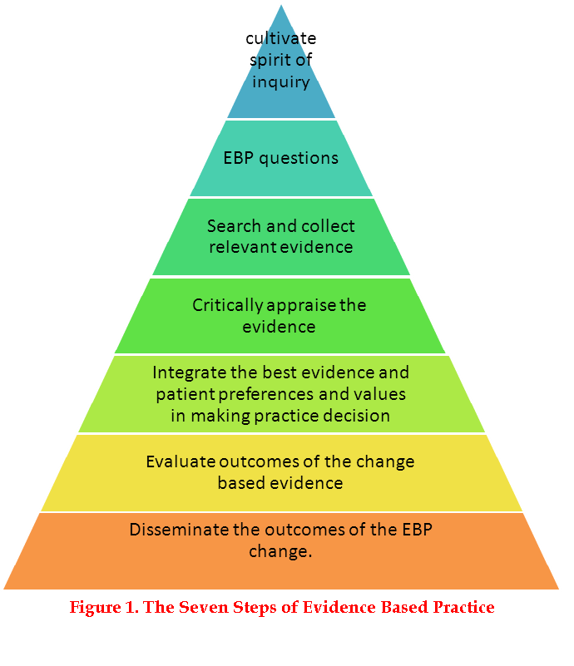

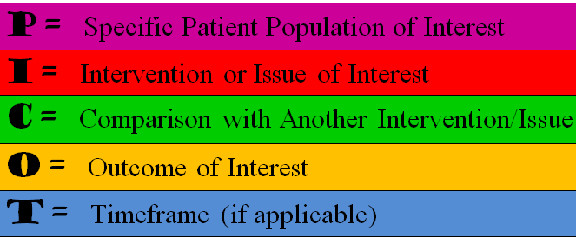
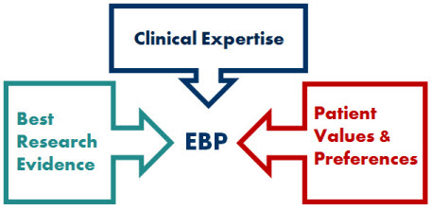
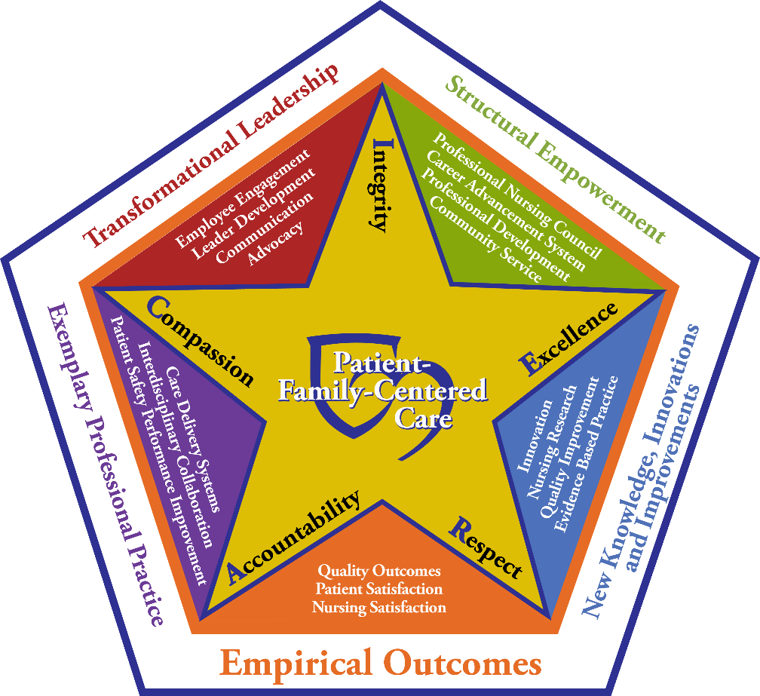

An Evidenced-Based Practice Immersion Experience: The Impact on Nursing in a Hospital Setting
Sandra L. Price, MS, RN, CAPA, Ambulatory Surgery Center
Mary G. Carey, PhD, RN, FAHA, FAAN, Associate Director, Clinical Nursing Research Center
PROJECT OBJECTIVES
METHODS
OUTCOMES
Differentiate evidence-based practice (EBP) from research and quality improvement initiatives
Share Center for Transdisciplinary Evidence-Based Practice (CTEP) Immersion Workshop Experience led by The Ohio State University (OSU) School of Nursing (Dr. B. Melnyk & Dr. L. Gallagher-Ford)
Develop clinical EBP mentors and leaders in Nursing Practice at
the University of Rochester Medical Center (URMC)
Utilize a step-by-step EBP process to guide clinical inquiries and decision-making
Transform the organizational culture to foster curiosity and
integrate EBP in daily practice
The 7-Step Evidence-Based Practice Process
Certified n=21 EBP mentors and leaders at URMC
Initiated n=21 URMC service projects
Improve outcomes for patients, staff, & the organization
Mentor clinical nurses in EBP knowledge, skills & tools to engage in best practices
Ability to critically appraise evidence
Increased use of medical librarian to search for evidence
Increased inclusion of evidence in nursing policies
Increased inclusion of at least two evidenced-based articles to support nursing-initiated projects
Learned to formulate clinical questions using PICOT format
BACKGROUND
Source: Melnyk, B., & Fineout-Overholt, E. (2011). Evidence-Based Practice in Nursing & Health Care. A Guide to Best Practice. (2nd Edition). Philadelphia: Wolters Kluwer/Lippincott Williams & Wilkins.
Integrating research findings into practice and policy is often delayed
EBP is focused on implementing knowledge through practice change in a narrow population and measuring outcomes
CTEP program discovered at national Magnet conference by URMC attendee
In July 2016, OSU EBP leaders, Drs. Melnyk & Gallagher-Ford Provided a 5-day EBP immersion
Utilizing an EBP process can accelerate best practices and improve patient outcomes
Individual participants analyzed a clinical problem on Day 1 and by Day 5 presented project findings and recommendations
CTEP program focused on search strategies, critical appraisal, integration and implementation of evidence
Classroom discussions and group activities with mentored workshop sessions
PROFESSIONAL PRACTICE MODEL ALIGNMENT
CONCLUSIONS/IMPLICATIONS
Transformational Leadership: Inspire and sustain an EBP culture
Structural Empowerment: Develop professional expertise in new EBP mentor/leader role
Exemplary Professional Practice: Disseminate EBP recommendations to improve patient care delivery
New Knowledge, Innovations & Improvements: Integrate EBP skills and findings in daily clinical practice
Empirical Outcomes: Implement EBP to incorporate standards of practice linked to positive patient outcomes
Engage in networking with EBP mentors/leaders globally
New EBP resource for clinical nurses at URMC
Formal EBP mentor and leader group meetings
Establish EBP education
Access to monthly CTEP webinars
Guide best practice changes based on current evidence
Promote EBP in daily clinical decision-making
Encourage innovation and organizational project dissemination
Create an EBP environment that supports best practice and achieves quality patient outcomes
SETTING/PARTICIPANTS
URMC nursing applicants, n=21 were selected to participate in a 5-day EBP intensive immersion
Nurses, n=14 multiple specialty services at URMC
CTEP trainers, n=5 from Ohio State University in an internationally recognized program
EBP mentors, n=19 and EBP leaders, n=2
National Nurses’ Week Best Practice Showcase, 2017

