Slide 1
NEW!
Outcomes: Reports from Researchers/Investigators
Surgical Attire Initiative
Christopher Cordella, BSN, RN, CNOR
Louise Kertesz, DNP, ANP-BC, CNOR
Nenita M. Nadera, MSN, CNS, CNOR

Slide 2
Recording and Copyright
Recording
Attendees are not permitted to record education sessions or slides, including use of audio, video, or still recordings. No cameras, electronics, or recording devices may be used during education sessions, including cell phones. Although permitted in session rooms, cell phones must be silenced.
Copyright
Copyright 2017 AORN, Inc. AORN’s training and educational materials are protected under federal copyright and trademark law. Only registered attendees may use our materials. Any unauthorized use of our materials is strictly prohibited. Violations of these requirements or of our valuable intellectual property rights may incur substantial penalties, including statutory damages of up to $150,000 for a single willful violation of AORN’s copyrights.

Slide 3
Faculty Disclosure
Christopher Cordella, BSN, RN, CNOR No conflict
Louise Kertesz, DNP, ANP-BC, CNOR No conflict
Nenita M. Nadera, MSN, CSN, CNOR No conflict
AORN’s policy is that all individuals who have the ability to control or influence the content of an educational activity must disclose all relevant relationships with any commercial interest. Relevant relationships must be disclosed to the learners during the time when the relationship is in effect and for 12 months afterward. All information disclosed is shared with the participants/learners prior to the start of the educational activity.
Salary
Royalty
Stock
Speaker’s Bureau
Consultant
Other (describe)

Slide 4
Acknowledgement
We would like to express our deepest gratitude to Ms. Catherine Ostroski, Director of Nursing for Perioperative Services.
We would also like to thank Dr. Anil Lalwani, Medical Director of Perioperative Services, for his continued support.

Slide 5
Objectives
Identify steps taken to initiate surgical attire made in ORs across six campuses of a nationally recognized urban teaching hospital.
Interpret compliance rates, culture changes, and practice sustainability over a six-month period.

Slide 6
Perioperative Quality/Safety Specialist
Roles/Responsibilities
  Unit Rounding
    Attire
    Universal Protocol (Time-Out)
    Surgical Counts
    Immediate-Use Steam Sterilization (IUSS)
    General Survey Readiness
  Infection Control Liaison
  Staff Education
  Perioperative Steering Committee Organizer
  Investigate/Compose Quality Reviews

Slide 7
Surgical Attire Initiative Timeline
Staff Meetings, Administrative Notice, Department Chair Buy-in
December 2015-January 2016
Policy Change, Quality Rounding, Mandatory Bouffants/Jackets/Hoods
January-February 2016
CMS Visit
December 2015
Implementation of Burgundy Scrubs for Operating Rooms ONLY, Monthly Updates at Cross-Campus Perioperative Steering Committee
Ongoing 2016-2017
Daily Rounding Continues with Non-Compliance E-mails from Medical Director
Ongoing 2016-2017

Slide 8
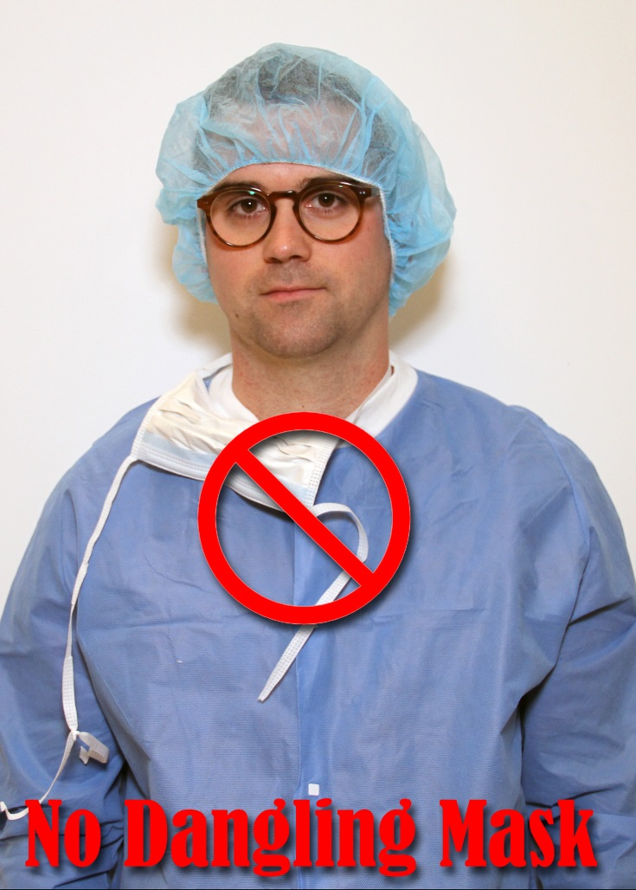
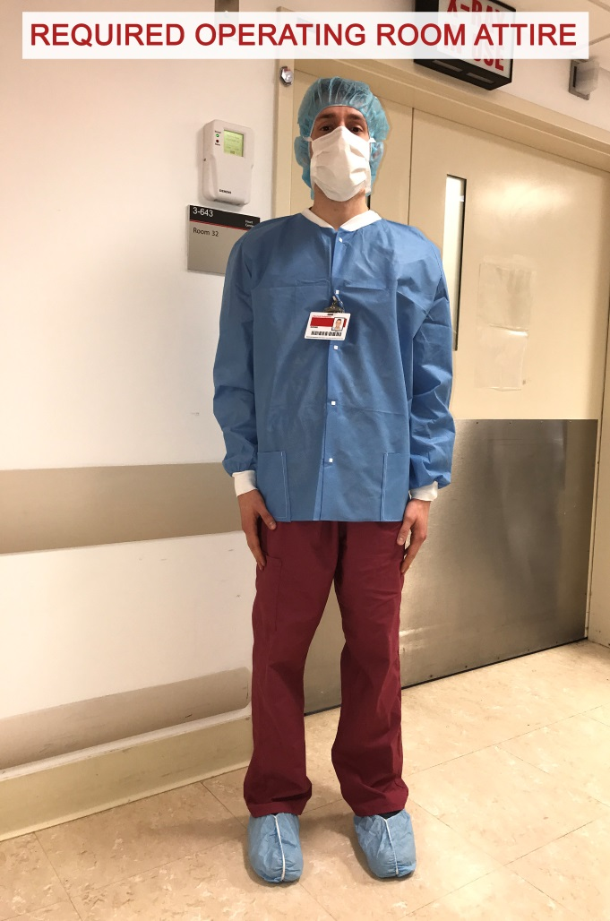
Tools of the Trade

Slide 9
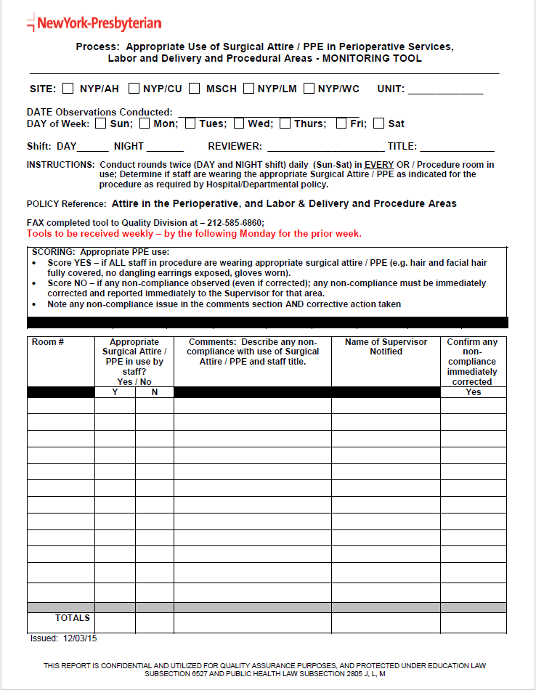
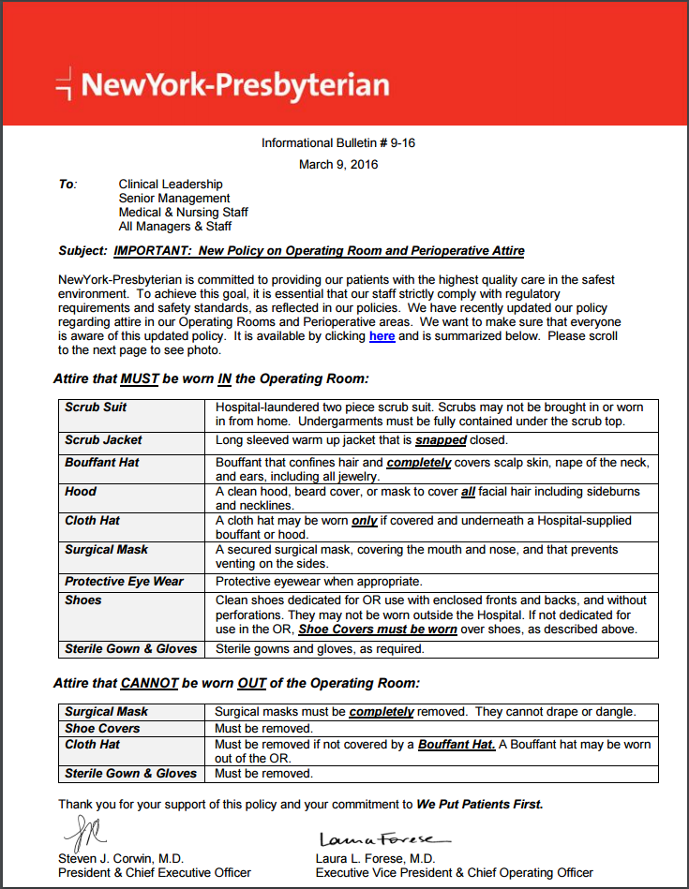
Tools of the Trade

Slide 10
Perioperative Team Effort
Pre-op Area
Operating Rooms
Post Anesthesia Care Unit (PACU)

Slide 11
Compliance Rates

Slide 12
Evidence-based References
Association of periOperative Registered Nurses (AORN) (2016). Guideline for Surgical Attire. In Guidelines for Perioperative Practice (2016 Edition) (pp. 95-117). Denver, CO: AORN.

